Slide 1
Business case Ironhack strategy 2024
Ruoxi Hou

Slide 2
AGENDA
Introduction​
Competitor Comparison
​Suggestion​
Technicality
Reference

Slide 3
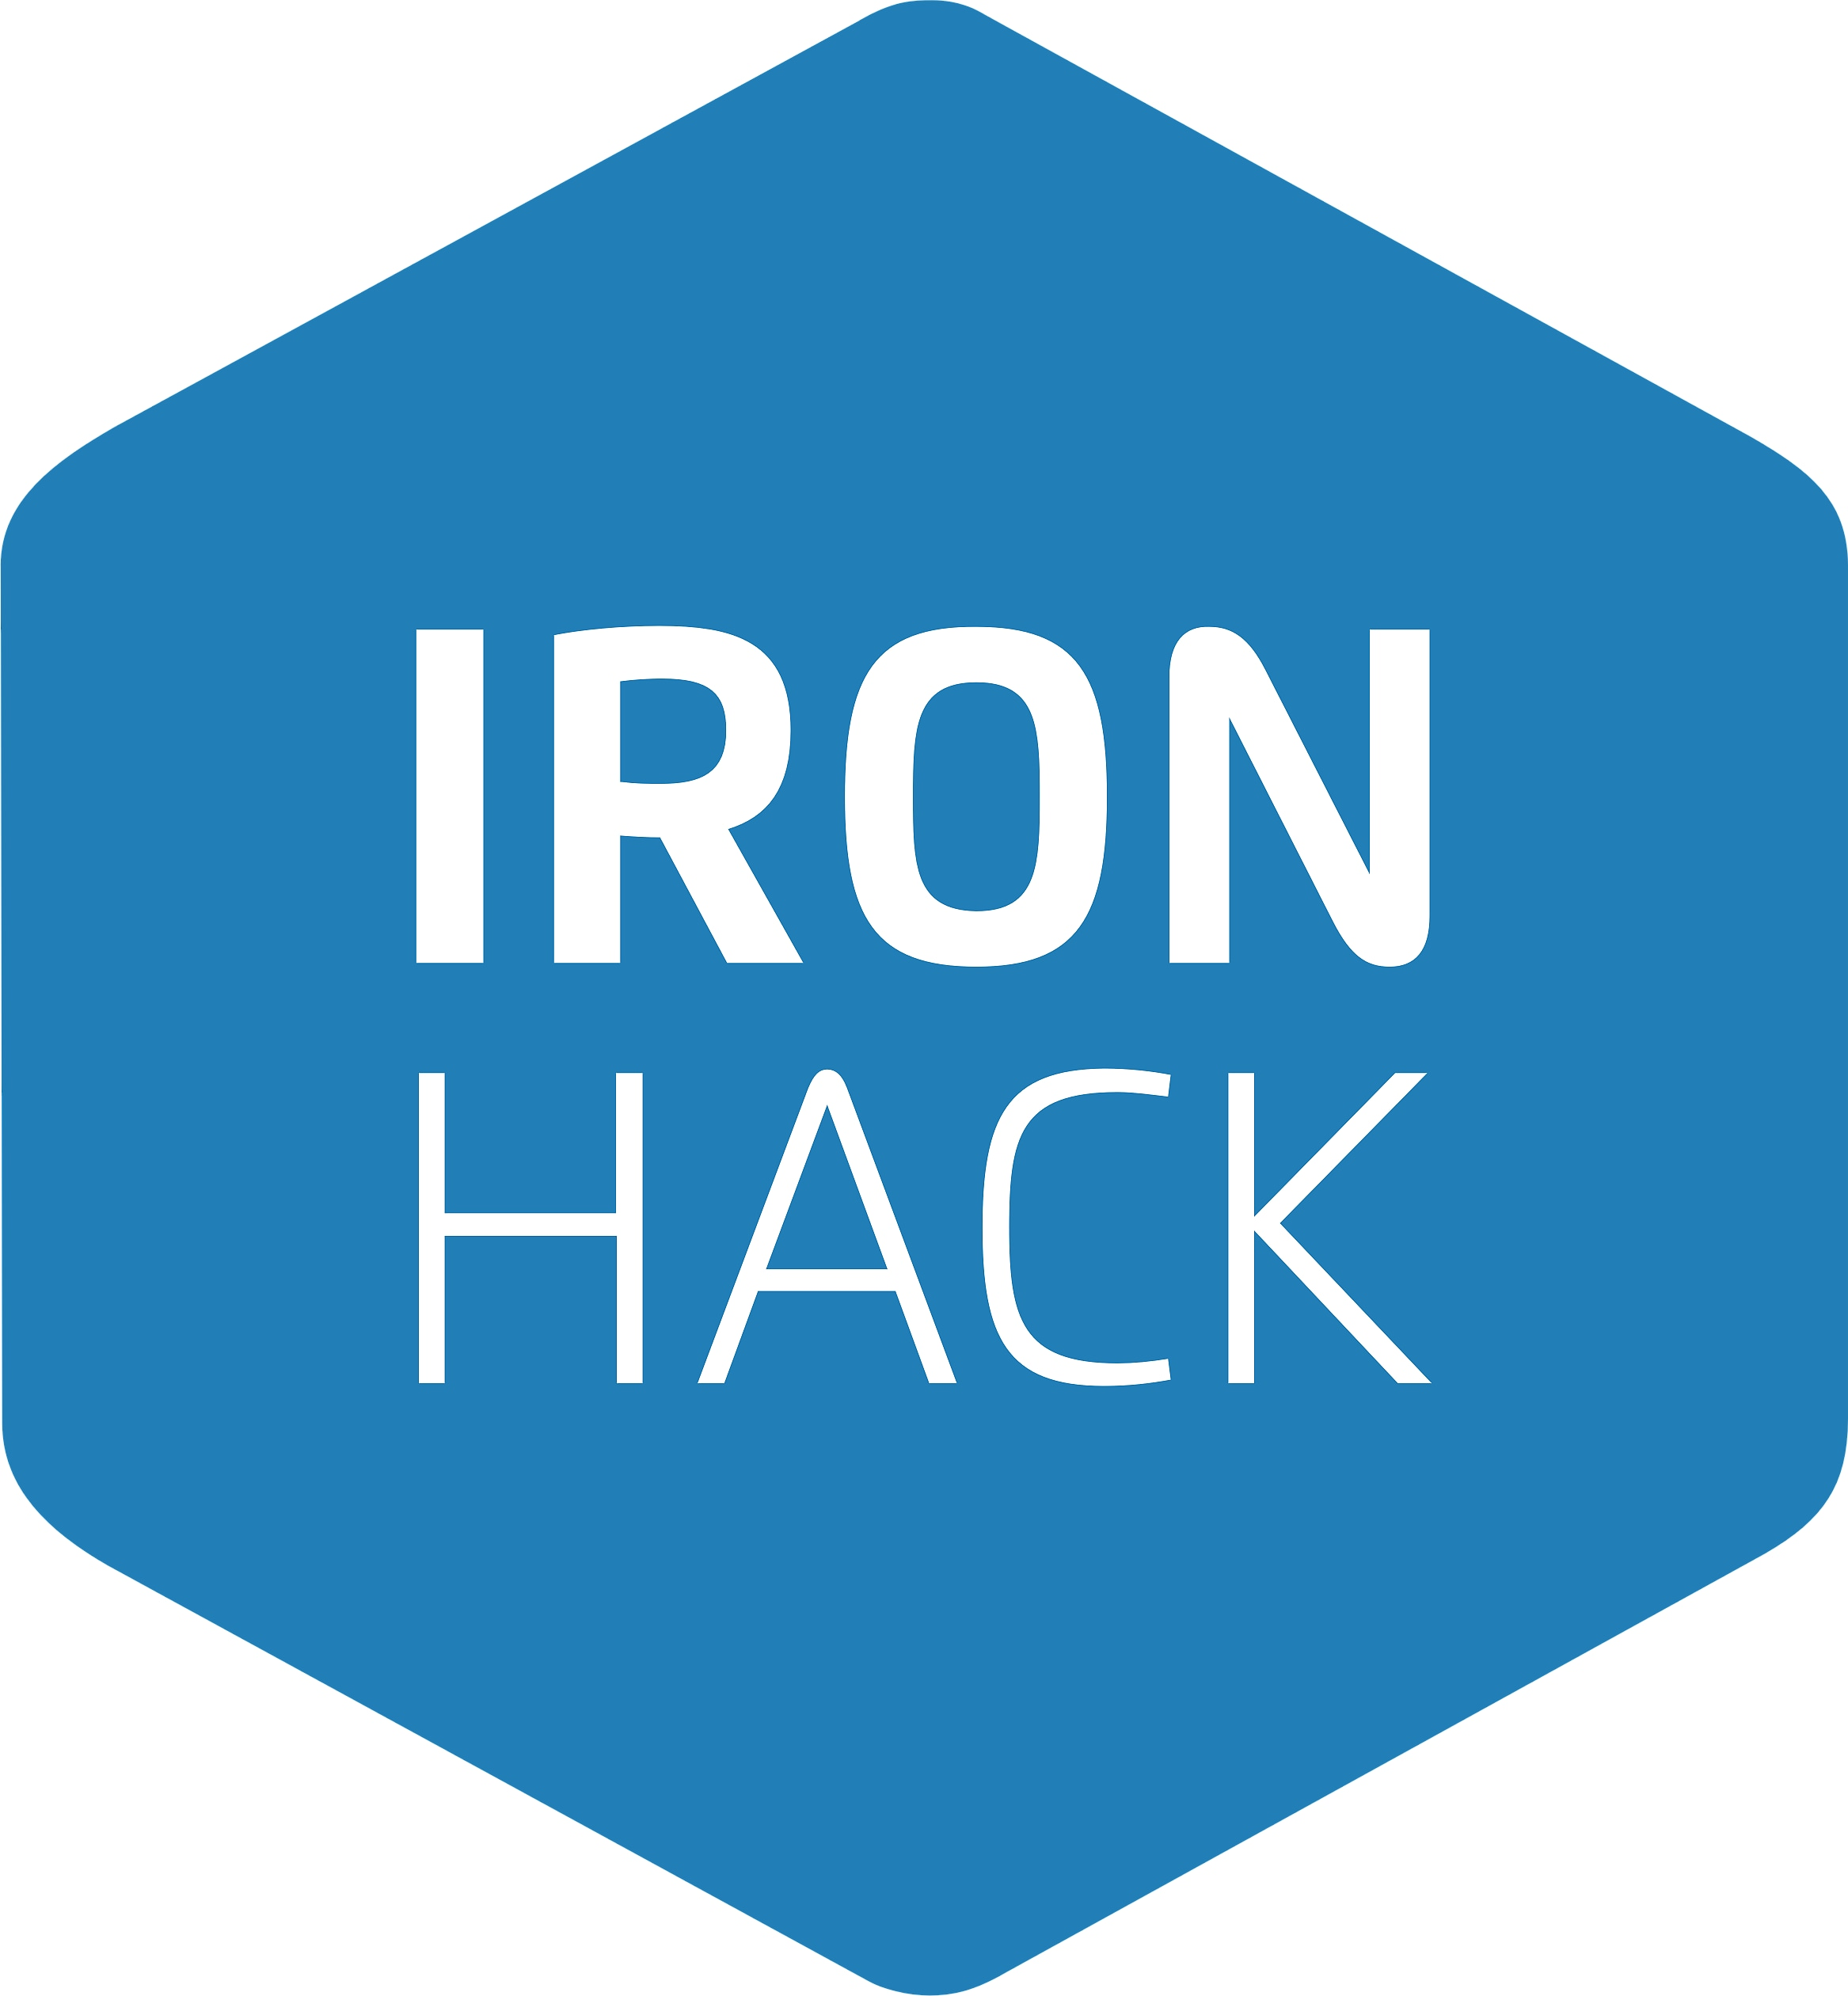
Introduction
As the stackholders from Ironhack, we want to understand who are our real competitors, and what strategies we can apply at the beginning of year 2024 to improve the business performance of Ironhack as a whole

Slide 4
Competitor comparison

Slide 5
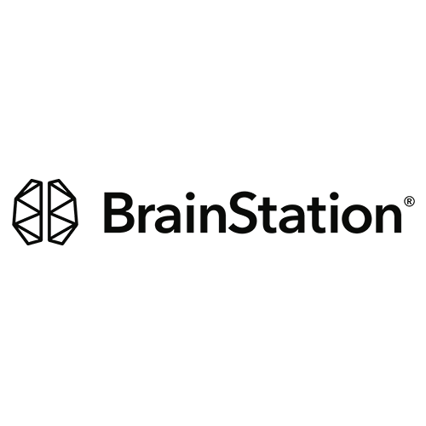


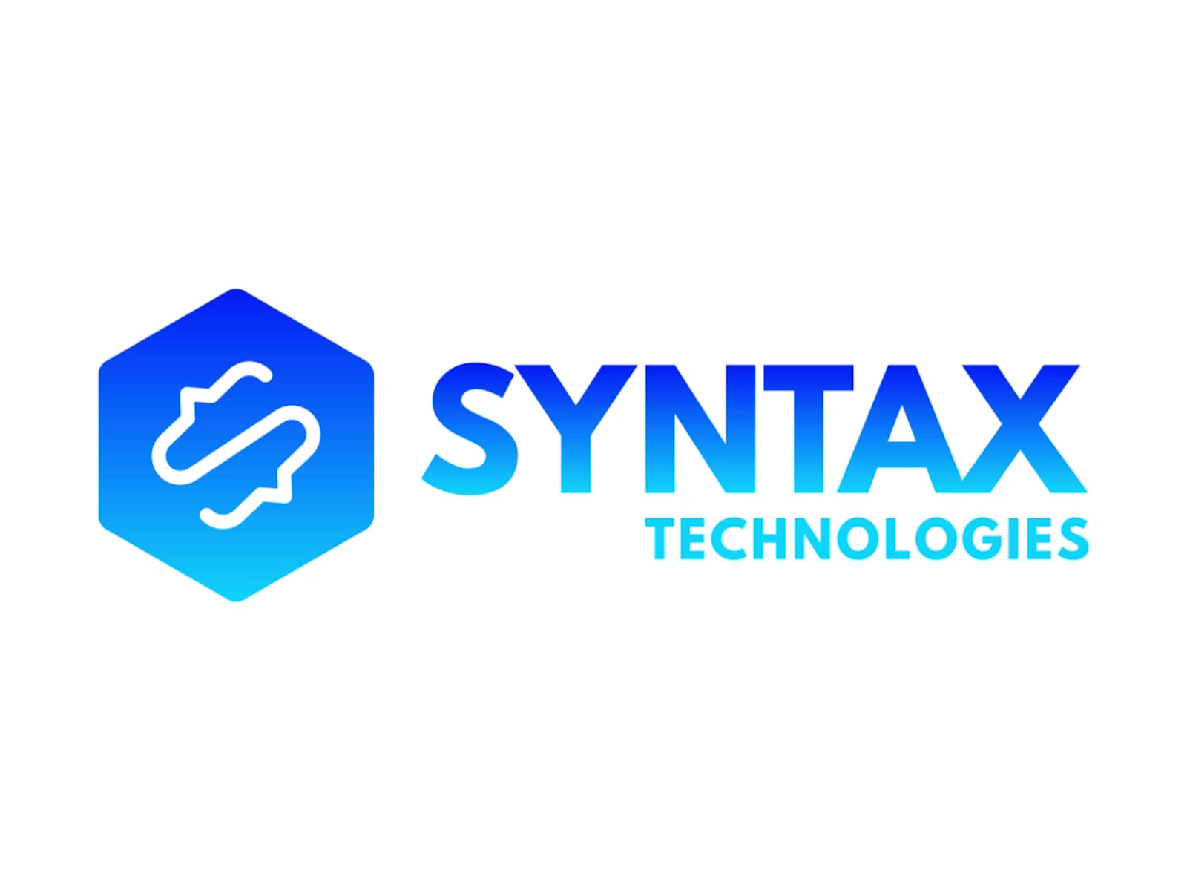
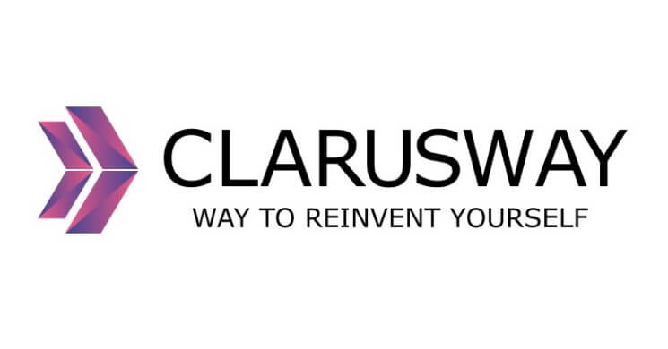
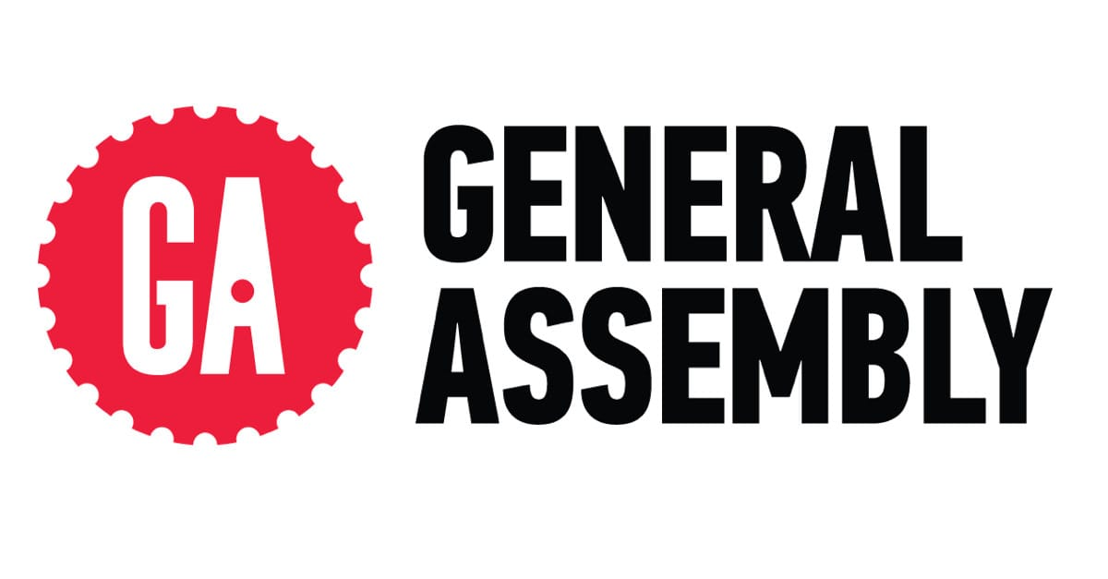
Schools included
Springboard
Le Wagon
brainstation​
Syntax technologies
Clarusway
General Assembly

Slide 6
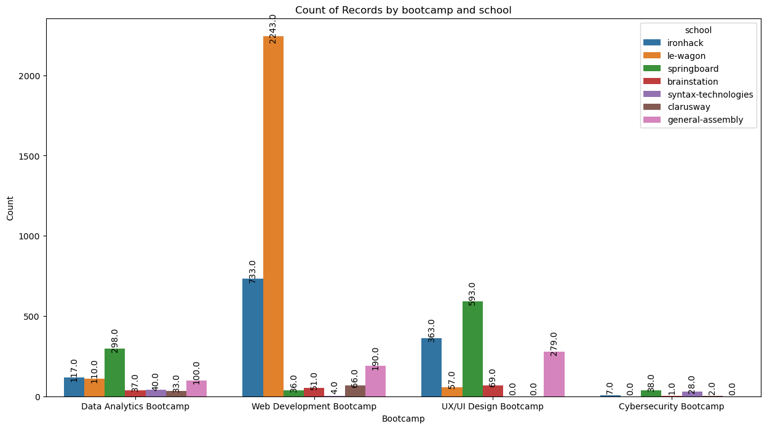
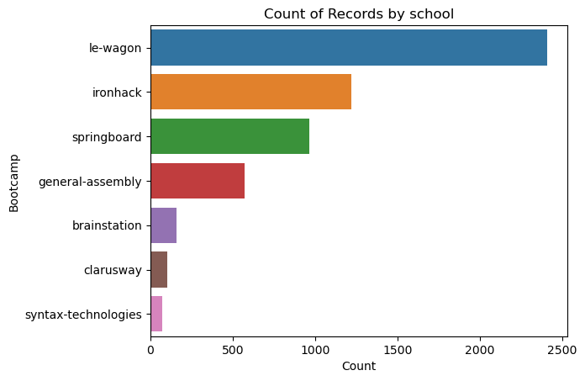
Le Wagon has the most reviews in general, and the most reviews for web development bootcamp; Springboard has the most reviews for UX/UI design bootcamp and Data Analytics bootcamp; Cybersecurity bootcamp in general has the least reviews all over the schools;
We would focus on le Wagon, Springboard, General Assembly and Brainstation next.

Slide 7
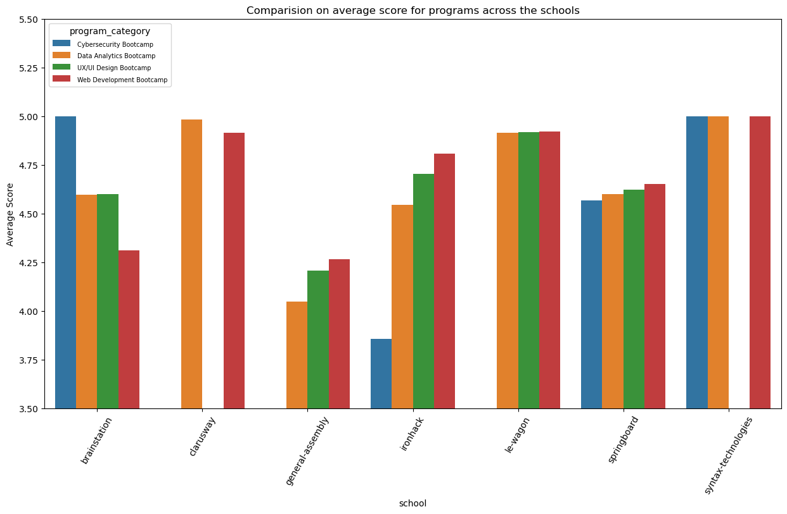
The largest difference of the performance compared to overall performance mainly comes from Data Analytics and Cybersecurity, which might be the areas we want to improve more, depending on the job market trends Considering General Assembly does not have any bootcamp that receives higher score than Ironhack and also less reviews, we won't consider General Assembly as a competitor of Ironhack. Therefore, our focus of competitors becomes Le Wagon, Springboard and Brainstation.

Slide 8
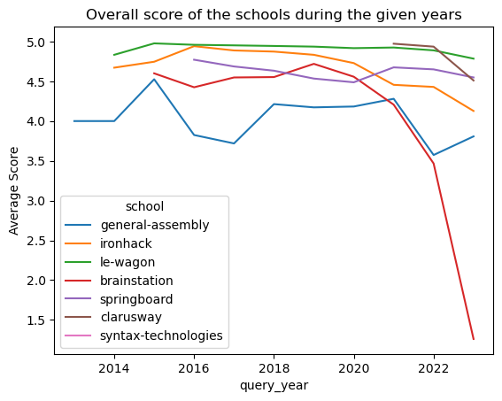
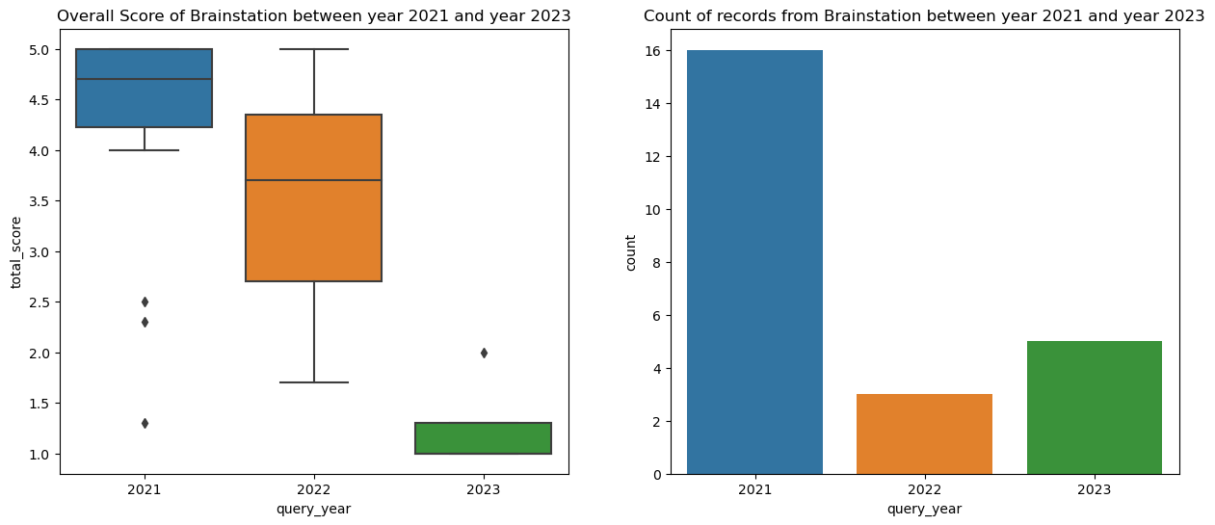
Ironhack's average score is consistently decreasing since 2016 from 4.8 to 4.2; An interesting pattern shown by springboard is that it is the only one with score increasing after pandemic 2020 and still maintained in the relatively high level; Le Wagon is always given with highest score expect in year 2021; There's a very strange trend about the overall score from Brainstation in the last 3 years as it's dramatically decreasing.
Considering the fact that less reviews are given to Brainstation in the year 2022 and year 2023, and the percentage of bad reviews is getting bigger, we rule out Brainstation as our competitor. Now our competitor scope is narrowed down to Le Wagon and Springboard'''

Slide 9
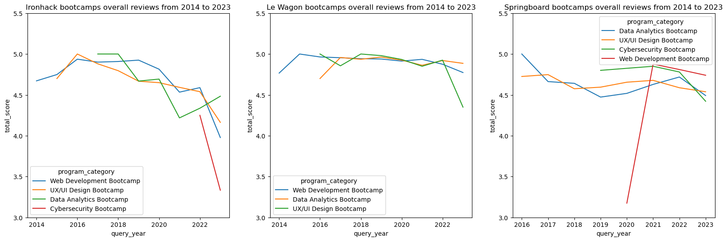
For future improvement: If we want to improve the performance of web development, we can learn from Le Wagon; springboard has more reviews regarding UX/UI design bootcamp than Ironhack and the overall score in this regard also is higher and more stable than Ironhack. If we want to improve the performance of UX/UI design bootcamp, we can learn from Springboard

Slide 10

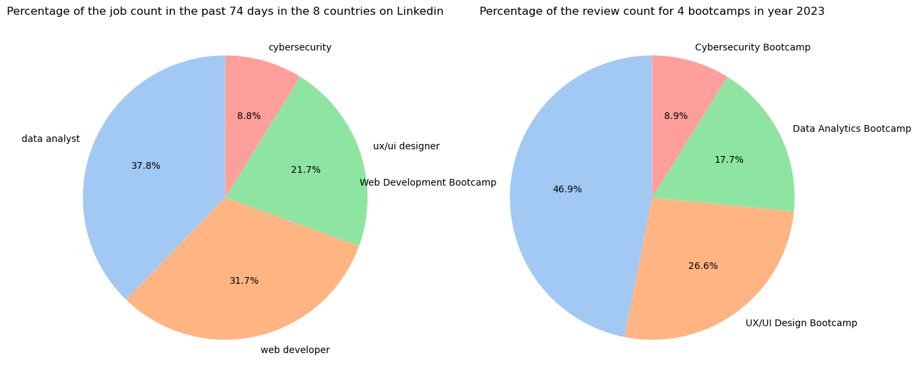
Web scrapping

Slide 11
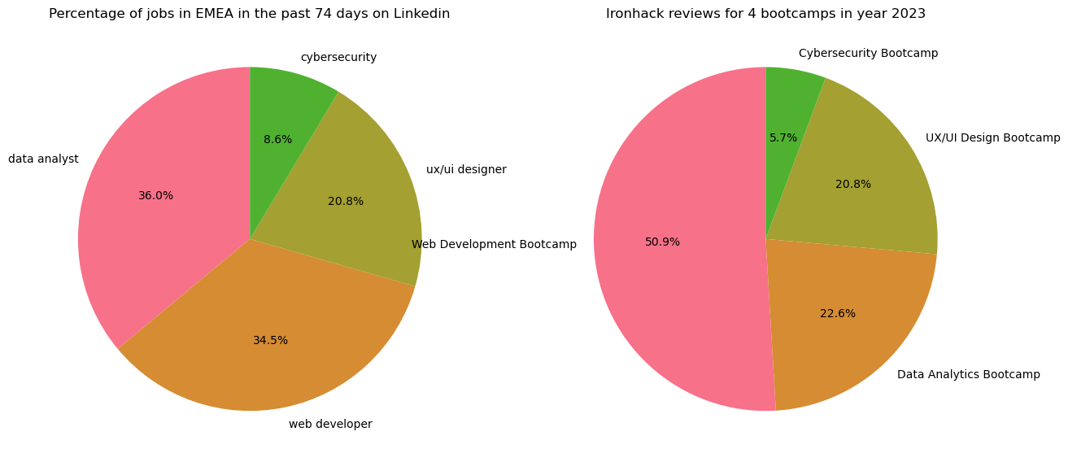
Web scrapping
Ironhack so far has less percentage of reviews than the jobs posted in terms of Cybersecurity in EU area; Web development reviews have been over produced compared to the job market demand; UX/UI Design is matching the job market demand; Data Analytics Bootcamp can be invested more.

Slide 12
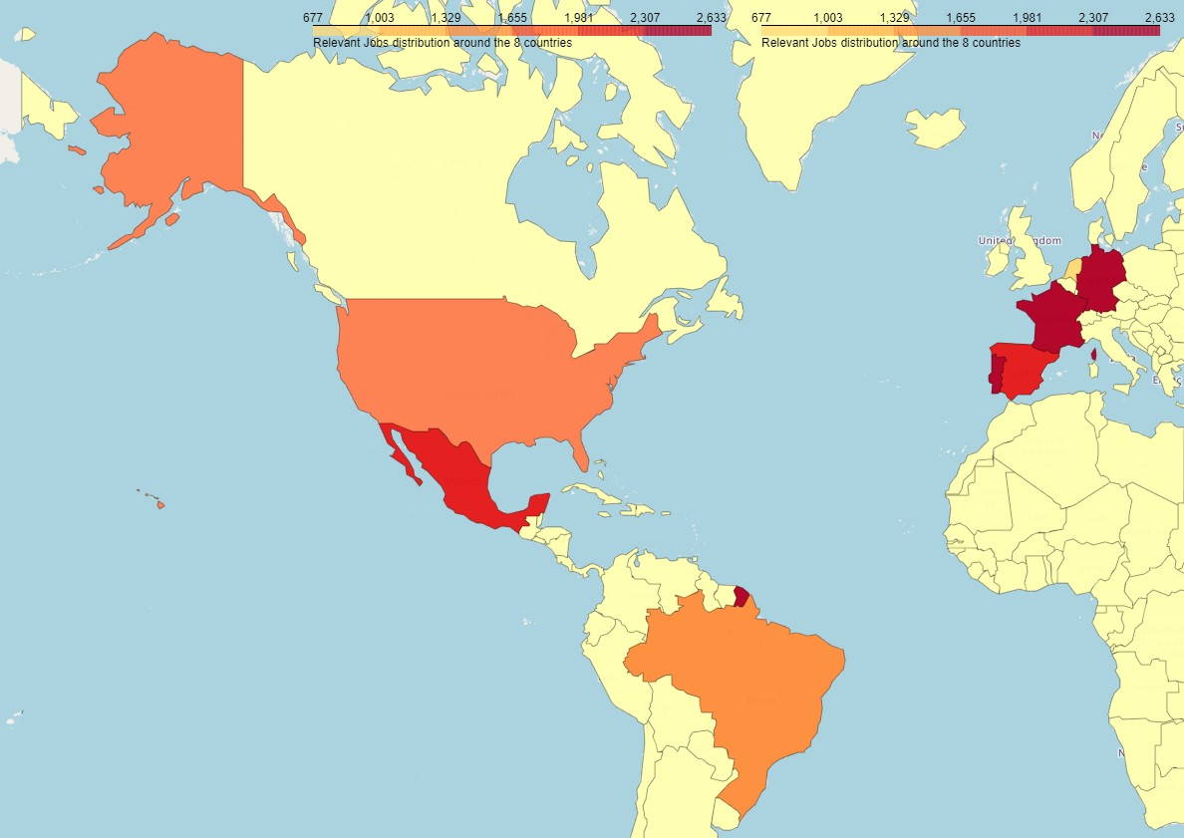
Linkedin job distribution

Slide 13
For the coming year 2024, global economic growth could slow to 2.6% from 2.9% this year. For the USA, the national unemployment rate ticked up a bit in august but remains low at 3.8%. The quit rate has trended downward while the number of job openings has dropped. This all suggests the labor market has slacked a little, but just a little. Overall, a rebound in growth is expected, with GDP growth forecast to improve in 2024 – to 1.3% in the EU and 1.2% in the euro area. For consumers, inflation in the euro area is going in the right direction, declining to its lowest level in two years, to 2.9% in October, from its 10.6% peak a year ago. It is set to continue this downward trend in 2024.
Background research
“
”

Slide 14










Suggestion FOR Year 2024
EU
MARKET
increase
Maintain/
Increase
Maintain
Maintain/
decrease

Slide 15
conclusion
Compared to the US current figure in terms of the relevant job posts, EU region looks having more. Besides, prediction about the EU indicates that big corporates in the EU would probably not rush to reduce more budget and to outsource the business on top of the measures being implemented this year.
Considering Le Wagon is main contributor for Web Development Bootcamp and is very dominant in EU region, while Springboard only offers online bootcamps, if Ironhack does not want to invest more on expanding the business in the short term, it can relocate the resource from Web Development Bootcamp to Data Analytics Bootcamp to meet the demand of the labor market and to achieve better business performance without spending more money;
Cybersecurity is the new trend, and the ratio of Cybersecurity may increase very quickly next year.

Slide 16



technicality
Languages
libraries
challenges
Python
SQL
Pandas
Matplotlib
Seaborn
BeautifulSoup
Requests
Folium
Small Sample Size of the reviews
Unifying bootcamp names
Differentiating the job titles
Correlating job titles with the bootcamps

Slide 17
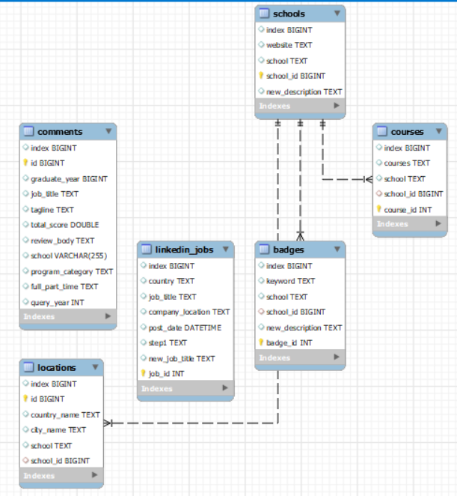
SQL DATA import

Slide 18
references
Global economy to slow down but likely avoid recession in 2024 | Reuters
Inflation Projections For Corporate Budgets In 2024 And Beyond (forbes.com)
Inflation forecast to drop further and EU economy to show modest upturn (europa.eu)

Slide 19
THANK YOU

